Slide 1
Learning Together 3: What will be?

Slide 2
How do we
‘make it happen’?
A story…

Slide 3
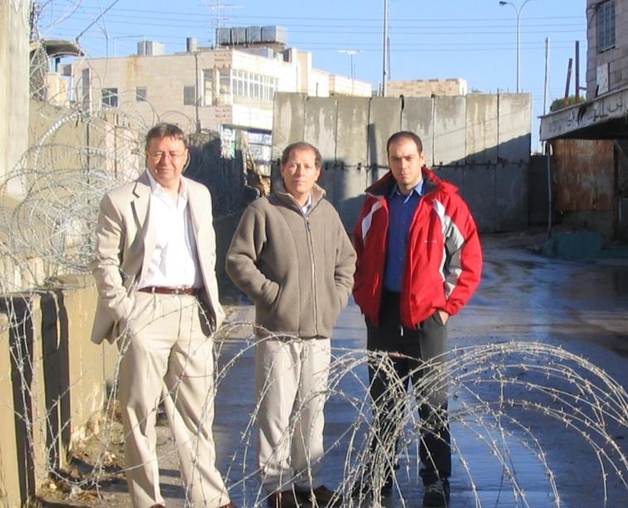
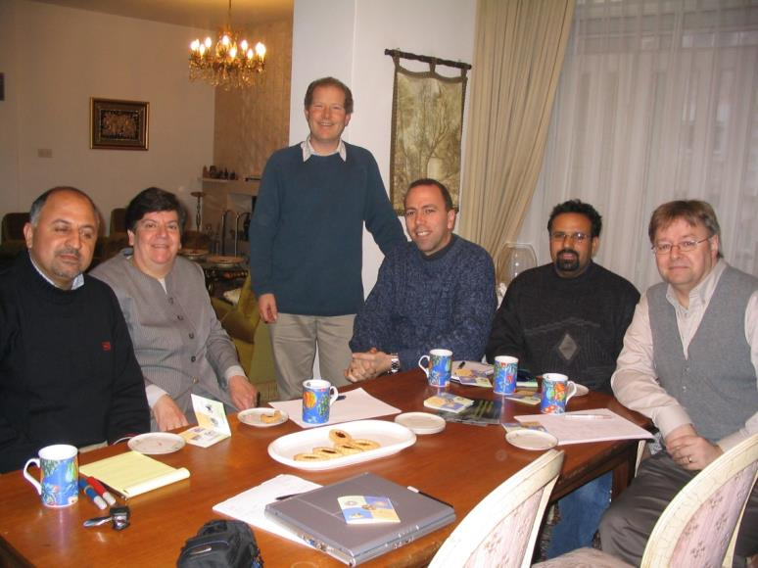
Exploratory visit with no agenda, Nov 2004
Workshop Feb 2005, seeking to “create robust jobs”

Slide 4
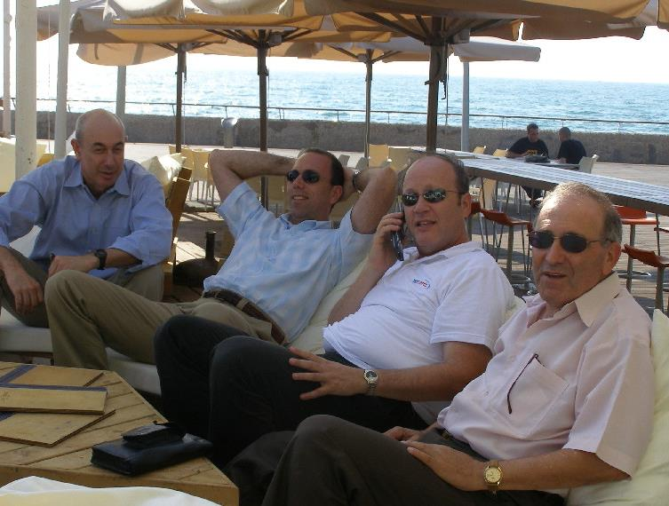
The BHAG: Palestinians and potential Israeli partners, Tel Aviv July 2006

Slide 5
Finally… breakthrough

Slide 6
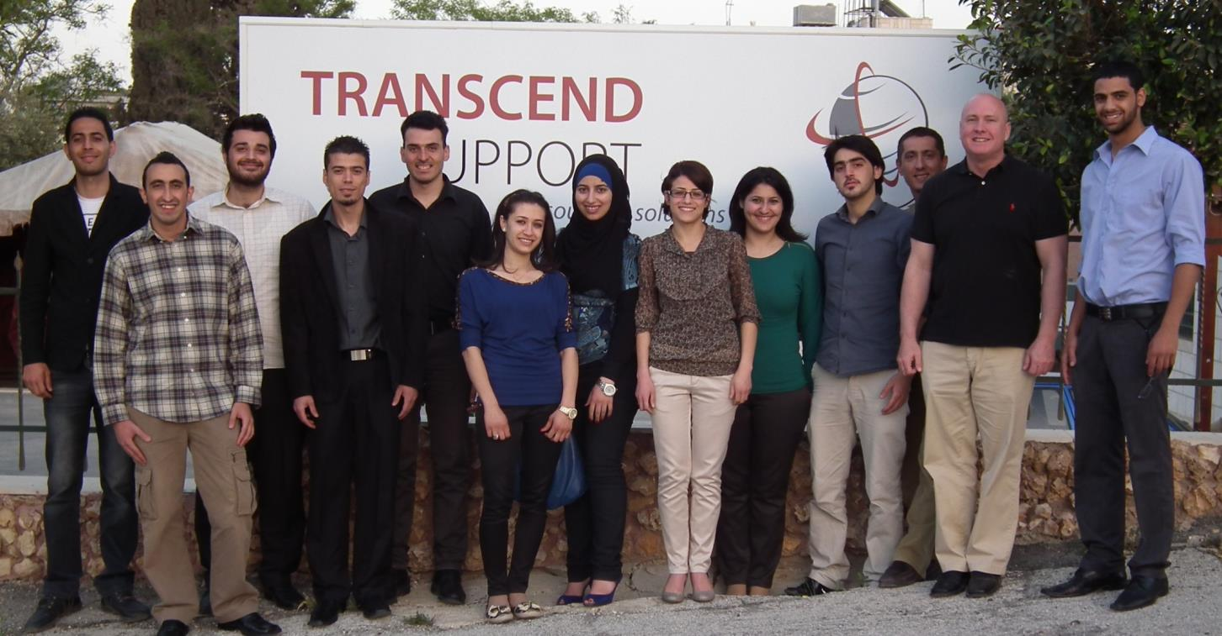
First recruits, April 2012

Slide 7
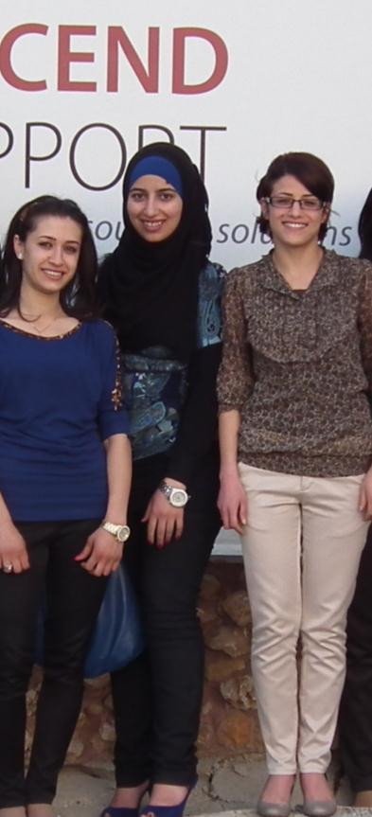
This transcends political barriers and limitations. I really love that. I am the eldest daughter in the family and I am my family’s hope… I love it because it makes me feel renewed every day because I learn about other cultures and it helps my English come to life.”
Yaman Qaraqe

Slide 8
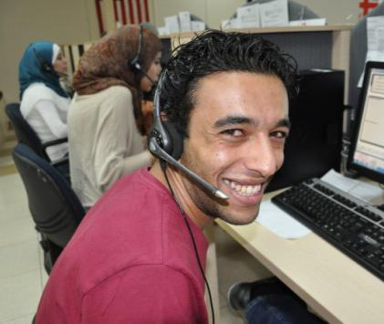
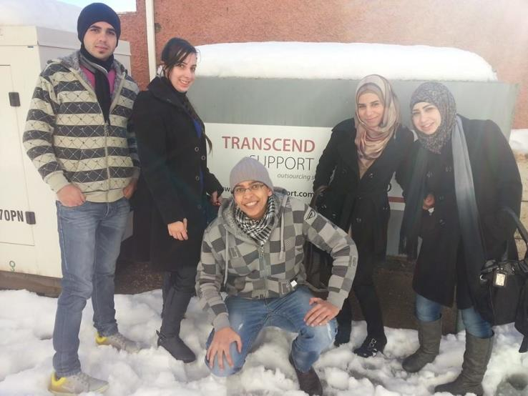
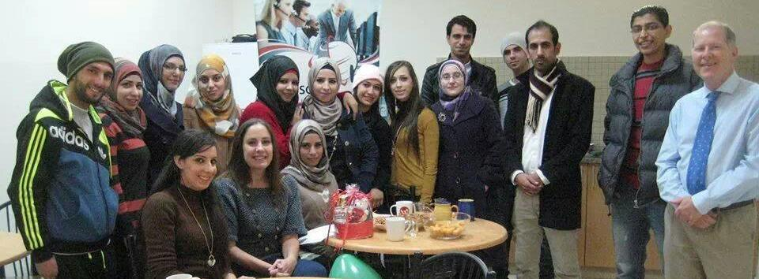
Notes:
Nearly bust 2013… now…

Slide 9
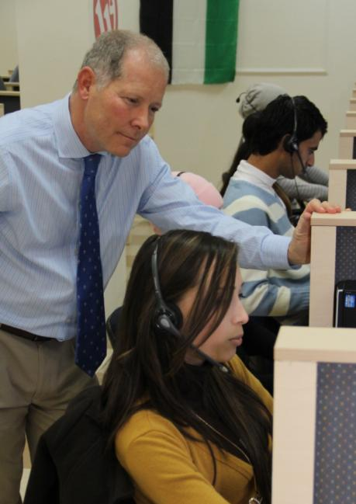
Some lessons…
Identify needs
identify resources
Set goals
Work with others, discerning the way forward
Take a risk
Keep on communicating
Keep on praying
Persist
The fruit comes from God not our efforts

Slide 10
Making it happen
Passage planning
Adjusting the course
Notes:
Sailing / Jesus time management

Slide 11
What’s the best sequence to go from dream to reality?
Notes:
Exercise

Slide 12
Pray all the time!
Community audit
Identify need / opportunity
Understand skills and resources available
Explore with the congregation / other interested parties
Produce a one page summary proposal with goals / objectives
Discuss and develop plan with key people of influence
Seek potential partners
Put together a timetabled, costed action plan
Inform the wider community
Seek funding
Pull together a team
Launch!
Notes:
NB. No one right answer, sequence depends on circumstances

Slide 13
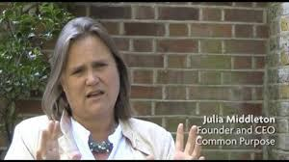
Leading volunteers
Summary:
“Lead with humility and self belief”

Slide 14
Jettison - giving instructions, strict hierarchies, and the instinct to tidy.
Expect the vitriol - there will be strong voices against you.
From what position will you lead - front, back, middle or side?
Don’t be in it for yourself – enjoy the achievements of others.
Be ‘multilingual’ - to communicate your passion to different groups
Involve outsiders – e.g. on your steering group

Slide 15
Build coalitions - does not require consensus.
Avoid distractions and diversions – delegate someone to sort emotive but less important issues.
Be patient – and ready for the right time.
Get the pace right – slow down to keep people with you without losing momentum.
Creativity and fun - people keep with leaders who are brave, and fun; count the laughs at meetings.

Slide 16
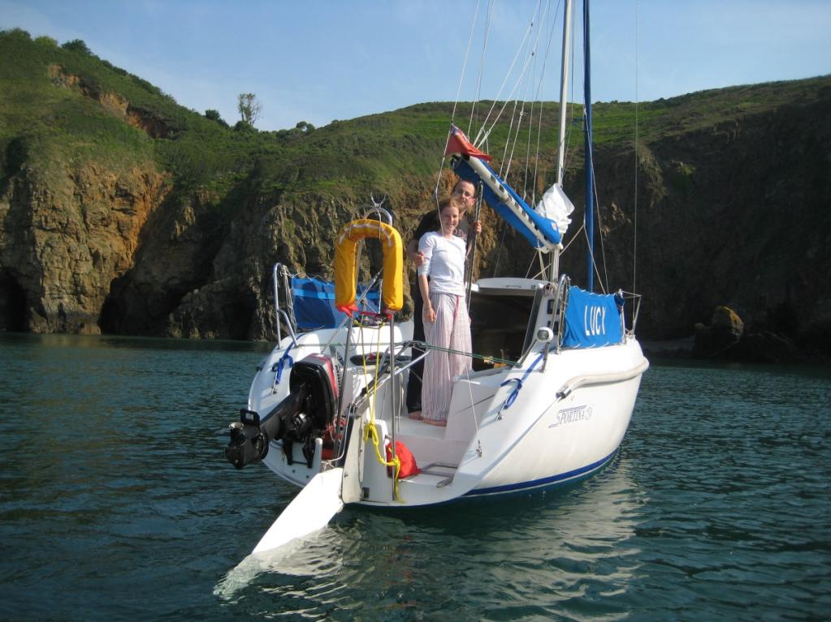
Finally… get under way!

Slide 17
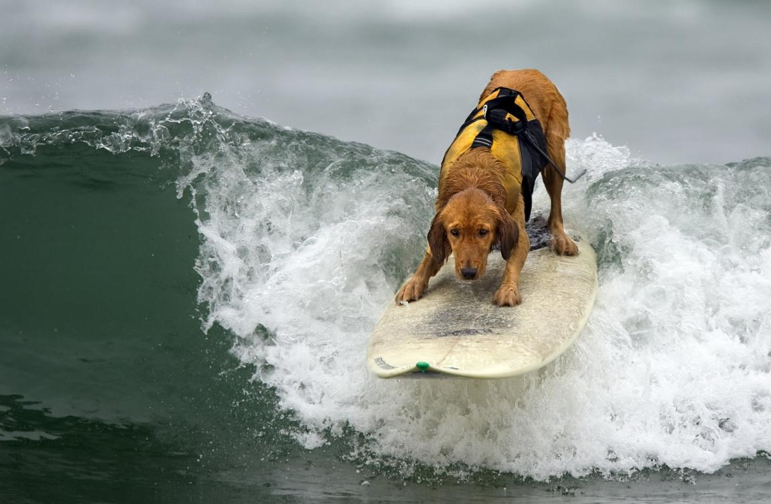
Try one audacious new thing each year!
Notes:
Transcend; HS2; church

Slide 18
Notes:
Add further case studies if available and if time

Slide 19
Introduction to group work
As a group, prepare an action plan using the template provided.
What needs to happen for your region to move towards the dream?
What can your group do to facilitate this?

