Slide 1

Learning Together
IRCA Conference Learning Community
New Zealand April 2018

Slide 2

Introduction to Learning Communities
Prayerfully developing a rural church missional plan for your region
Working together as a regional team, listening to and learning from each other
Inspired by stories from the learning community i.e. from other regions
YOUR context, YOUR strategy
Framework:
  What is
  What could be
  What will be

Slide 3

Legacy
An outline plan for your region to share and further develop
Actions you, your church or organisation can implement
An understanding of learning communities and materials you can adapt to your context to help inspire local plans.
Ongoing support from IRCA and your friends around the world.

Slide 4
Learning Together 1:
What is?

Slide 5
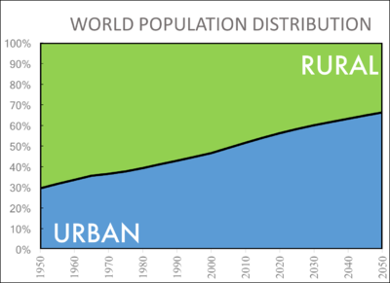
Global trends and implications for the rural church
Source: United Nations, Department of Economic and Social Affairs, Population Division (2014). World Urbanization Prospects.

Slide 6



Notes:
The world is changing and the speed of change is getting faster.
Gordon Moore noticed that computing power doubles and costs halve every 18 months. He thought it would last 10 years but “Moore’s law” has already lasted 60 years. The effect of this exponential change is extraordinary. To give one example: the Tsunami wave of innovation overwhelmed Kodak, a hundred year old $28bn 140,000 staff company. Facebook is now the business giant in the memory market, worth over $300bn with 13,000 staff. 10x the market value with one tenth of the staff. To give another example, the apps on my smartphone would cost you $900k if you tried to buy this technology in the 1980s. The rate of change is both hugely disruptive and also brings massive benefit.
The pace of change will get faster. Several technologies are at the point of creating massive change with both benefit and disruption: the internet of things; artificial intelligence; robotics; Genomics. Biotechnology is accelerating at 5 times the speed of Moore’s law: doubling in power and halving in price every 4 months. In 1995 they thought it would take 50 years and $15bn to sequence the first human genome. Now it takes a few hours and costs under $1,000.
This will change society and we will live ever longer.
It’s not just technology. We are changing our mind on social issues faster than ever before. In 1787, PA was the first US state to allow interracial marriage. It wasn’t until 1967, 180 years later, that it was legal in all states. In 2004, Massachusetts was the first state to all same sex marriages; just 11 years later, in 2015, same sex marriage became legal everywhere.

Slide 7
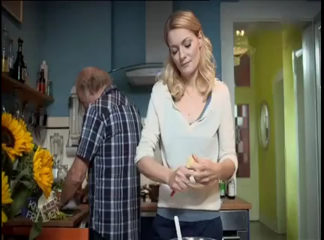
Notes:
Take a look at this. It doesn’t matter if you don’t understand it. You just need to know that the daughter is asking her father how he is getting on with the iPad she gave him for Christmas…

Slide 8
Challenges
Poverty
People have moved to cities for work
High transport and energy costs
Poor public transport
Local shops and services are disappearing
Cell phone and internet access may be poor
Decline in direct agricultural employment
Churches closing or clergy shared with other churches
Notes:
Despite all this change, many rural areas look as though they have escaped change. Apart from some new housing and maybe a few satellite dishes, villages often look much the same on the outside. But of course we cannot escape the changes around us. There has been massive change in rural communities and there remain many challenges.

Slide 9
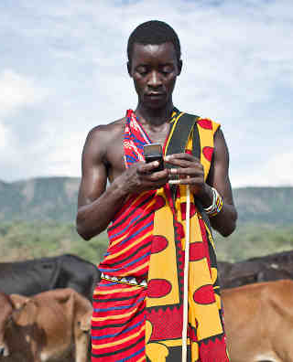
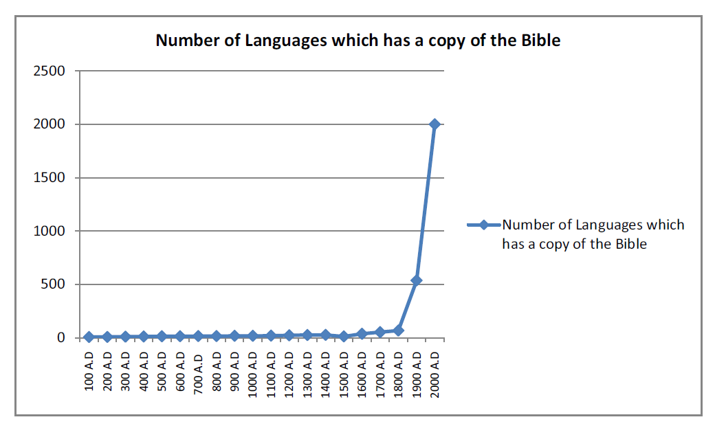
But…
Poverty is falling in many areas
Cell phones and the Internet are transformational
Material wealth isn’t everything
Bibles are now available in thousands of languages and Christian material is available digitally
Notes:
But there is good news too.
Poverty is falling in many areas. Here’s what the Newspaper India Today wrote in 2010: “Islands of poverty still exist but most of rural India is transformed beyond imagination thanks to a host of factors which has put unprecedented wealth into the hands of farmers across the country and turned it into a huge consumer market. We have a growing service industry and alternate revenue channels from horticulture, poultry, fisheries and other activities which are less rain-dependant and were virtually non-existent a decade ago. India's 6m villages, which harbour 72% of the population, once the albatross around its neck, are now the signpost to its future”
Cell phones and the Internet are transformational. Sub-Saharan Africa has more than 650 million mobile phone subscribers. As a result, farmers have access to market prices so they can negotiate better deals; they have access to weather forecasting and micro-insurance to insure against poor weather; and they have cell phone apps such as iCow that track each cow’s gestation and feed schedules.
Even with this material progress, rural people recognise that material wealth isn’t everything. Human flourishing is much more than merely money. Here’s what BBC reporter Caroline Juler wrote in 2011: Life is tough in rural Romania. EU statistics say that nearly half the people here are living on or below the poverty line. If you think everyone is miserable, though, you are wrong. I was staying on a farm that supported seven people, three generations of one family. The house had no hot water or fridge and the lavatory was a compost latrine in the garden. But there was plenty of food and I have rarely met people with such a zest for living.
Finally, Bibles are now available in thousands of languages and Christian material is available on the Internet and over satellite TV channels. This is transformational for mission in areas where openly exploring the Christian faith is not an option.

Slide 10

Regional trends
Europe
Oceania
Africa
Asia
Americas

Slide 11
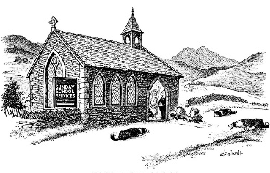
A view from England

Slide 12
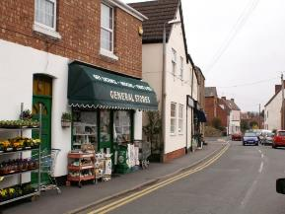
Rural context in England
17% (9m) people live in communities of under 10,000 in England
Older age profile:
  more over 45 year olds than urban
  fewer 15-29s
Net migration to rural approx. 50k p.a.
Uncertainty of Brexit
Impact of climate change especially flooding

Slide 13
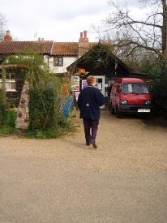
Types of rural people
Established rural residents
  the agricultural community
Commuters
Life style shifters
Privacy seekers / trophy owners
Migrant and transient workers
Second home owners
Tourists / visitors
Notes:
Rural communities vary across the country (commuter belt, relatively remote agricultural areas, tourist areas) and are made up of many different groups of people.

Slide 14
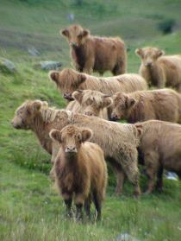
What’s good about rural?
Beautiful environment
Lower unemployment
Higher household incomes
Smaller numbers on benefits
Higher qualifications
Better health
Lower homelessness
Lower risk of crime
Notes:
Overall there are many good things about rural living in most but not all places

Slide 15
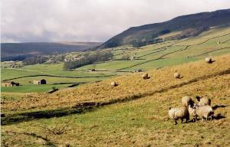
Rural disadvantage
Financial poverty
  Low wages, seasonal work, minimum wage, fixed pension, reliance on benefits
Access Poverty
  Transport, healthcare, Job Centre Plus, poor mobile and internet
Network Poverty
  Isolation, loss of supportive networks, family moved away for affordable housing
Notes:
But even in relatively wealthy areas there is poverty of different sorts, sometimes hidden

Slide 16
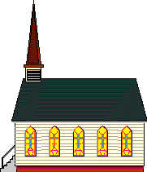

Challenges in rural mission
The days of one ordained minister / one church were brief and are long gone
The number of churches in a group will continue to grow in most areas
Need to move towards collaborative / shared ministry
Buildings can be a challenge
Most churches are small, with limited financial and leadership resources.
Notes:
The church situation can be challenging

Slide 17


BUT… a satsuma is not a failed orange
Notes:
The most visible difference between rural and suburban churches is usually size – BUT a satsuma is not a failed orange. A small rural church may be attracting a much higher proportion of the local population, and perhaps having a greater spiritual impact, than a large suburban church.

Slide 18



Opportunities in rural mission
Many feel a connection with the church and therefore a sense of journey of faith
Sense of connection with God the Creator and opportunities provided by agricultural seasons and traditions
Congregations are embedded in communities
Many churches are at the forefront of Fresh Expressions and ministry of the whole body of Christ
Opportunity to bring different groups of people in the community together
Ecumenical opportunities
Buildings can be an opportunity.
Notes:
There are many opportunities in rural ministry.
Note buildings can be both a challenge (layout, upkeep cost) and an opportunity (developing community uses).

Slide 19

What does the future look like?
Ecumenical
Growing ministry of lay people with leaders coaching and releasing others
A “mixed economy” that values both traditional and new.
Recognition that our involvement in the community is part of mission, part of being an “effective Christian presence”
A willingness to take risks
Notes:
So – how do we see the future for rural churches?
We hope and pray that it is ecumenical…
With a growing ministry of lay people with leaders coaching and release others
A “mixed economy” that values both traditional and new ways of being church (e.g. Messy church, café church, etc.)
A recognition that our involvement in the community is part of our mission: being a school governor, or on a village committee, or having tea with a neighbour, all these things are part of mission, part of being an “effective Christian presence”.

Slide 20
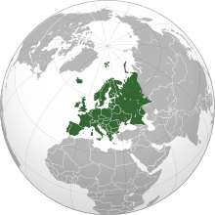
Other European perspectives?

Slide 21
Regional trends
Europe
Oceania
Africa
Asia
Americas

Slide 22
Regional trends
Europe
Oceania
Africa
Asia
Americas

Slide 23
Regional trends
Europe
Oceania
Africa
Asia
Americas

Slide 24
Regional trends
Europe
Oceania
Africa
Asia
Americas

Slide 25
Understanding ‘What is?’ for you
What is the Holy Spirit doing in your area?
What is the condition of the church?
What are the needs and opportunities?
Notes:
Intro

Slide 26
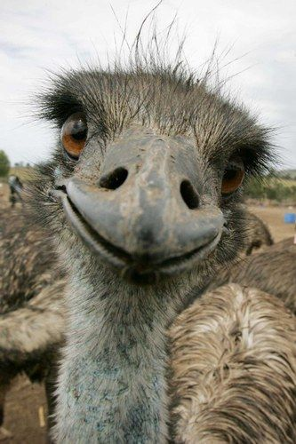





Warm up:
If you church was an animal, what sort of animal would it be?
Notes:
Warm up
… Here are a few options!
Exercise in 2/3s – 30 secs each
Brief plenary

Slide 27

How do churches in your area relate together?

Slide 28
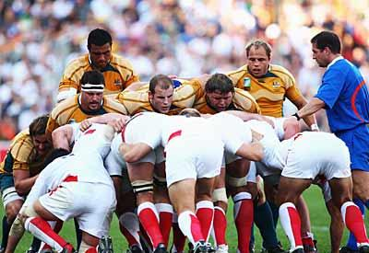
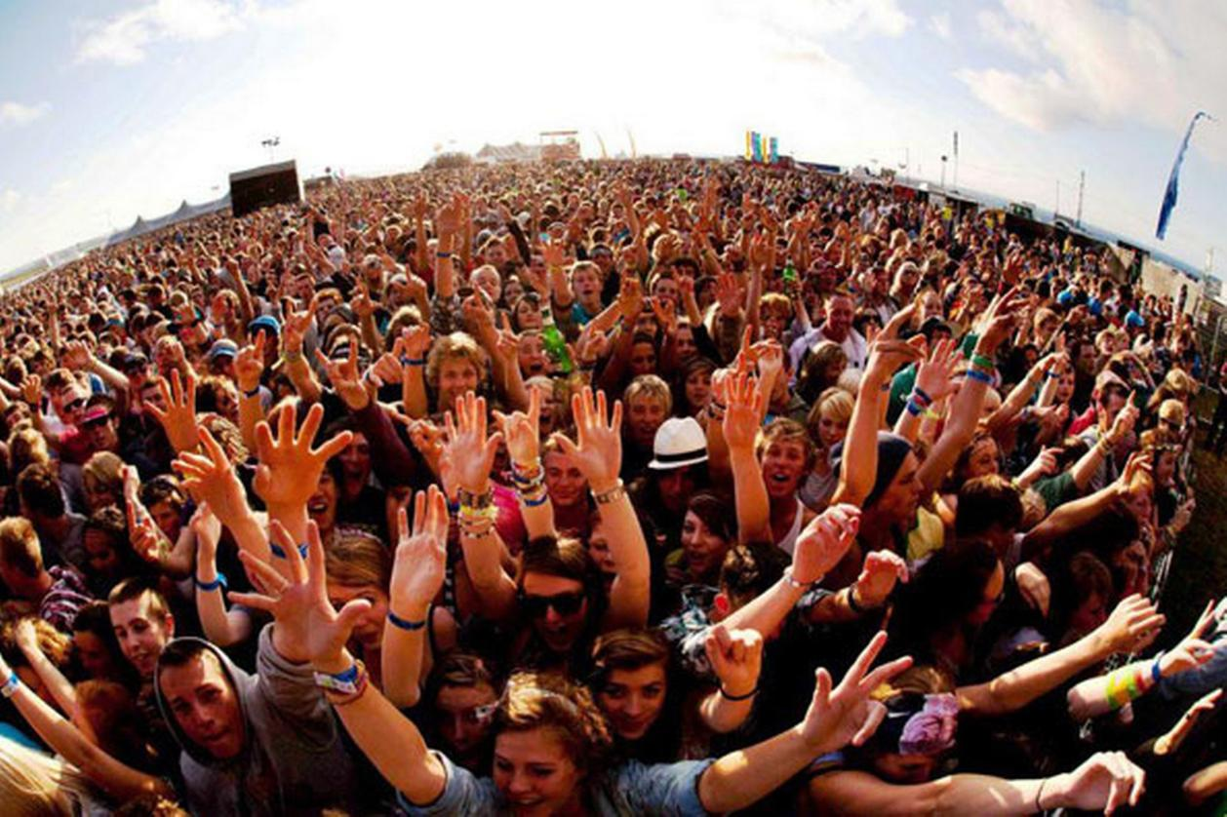
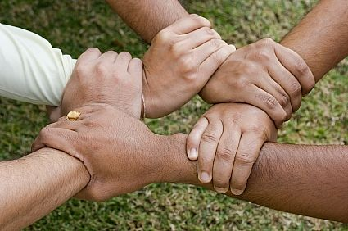
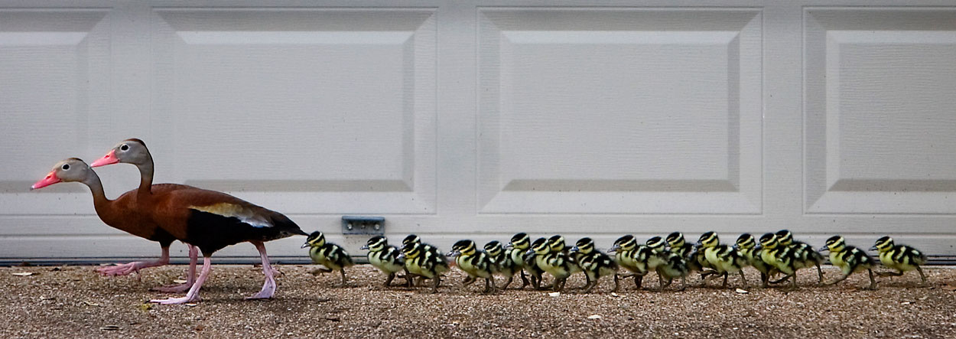
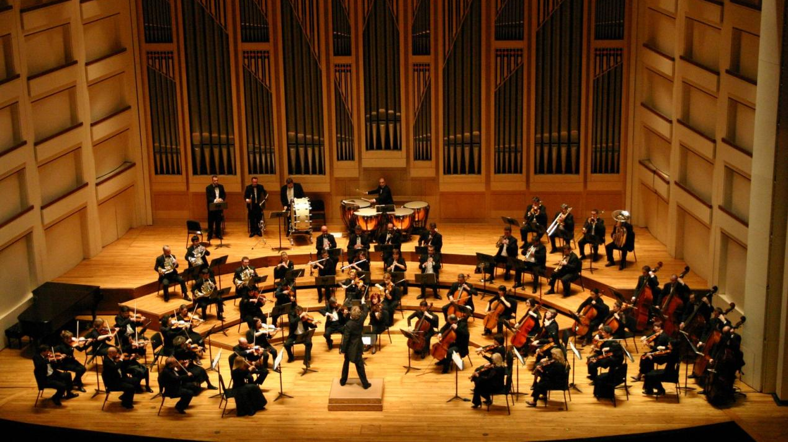
What are the relational dynamics?
Notes:
Are you a team, a crowd, network, a family, an orchestra?

Slide 29
axis exercise
Up
Worship, prayer and relationship with God
In
Growing together and caring for each other as a church community
Out
Reaching out through social action and evangelism
Of
Connecting with the wider church and working in partnership with others
Notes:
Read the boxes and thinking about your church group or a particular church, plot along each axis with a line where your rate the church currently for the four features described. A high value is closer to the box.
What do you feel about your response? Is there an imbalance? If you score high on ‘In’ and low on ‘Out’ are you just a clique? If you doing well on ‘Out’ but not on ‘In’ is there a danger of burn out? If you are low on ‘Up’ are you just a social club? If you are low on ‘Of’, could you make better use of resources be working with others in the church group or beyond?

Slide 30
Who is in your community?
Who is missing from your church?
How can you show God’s love to them?

Slide 31
Introduction to group work
As a group, review:
the state of the church
trends
challenges
needs and opportunities

